Slide 1
What we’ve done so far this week
Heat, work, and the 1st Law
Explore how that relates to the behavior of gases as they expand & contract
Constructed Carnot cycles
Today
Do some analytical work

Slide 2
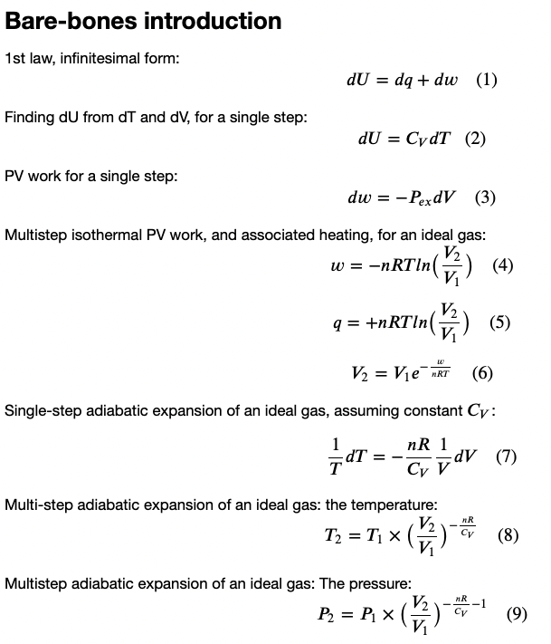

Slide 3








Isothermal PV work
$w=−nRTln(\frac{V_{2}}{V_{1}})$ ➔ $\frac{V_{2}}{V_{1}}=exp\left(−\frac{w}{nRT}\right)$
$$P_{ex}$$
$$P_{ex}$$
$$P_{2},V_{2}$$
$$P_{1},V_{1}$$
$$P_{ex}$$
$$P_{Ideal}=nRT/V$$
$$V_{1}$$
$$V_{2}$$

Slide 4

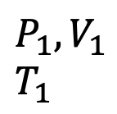


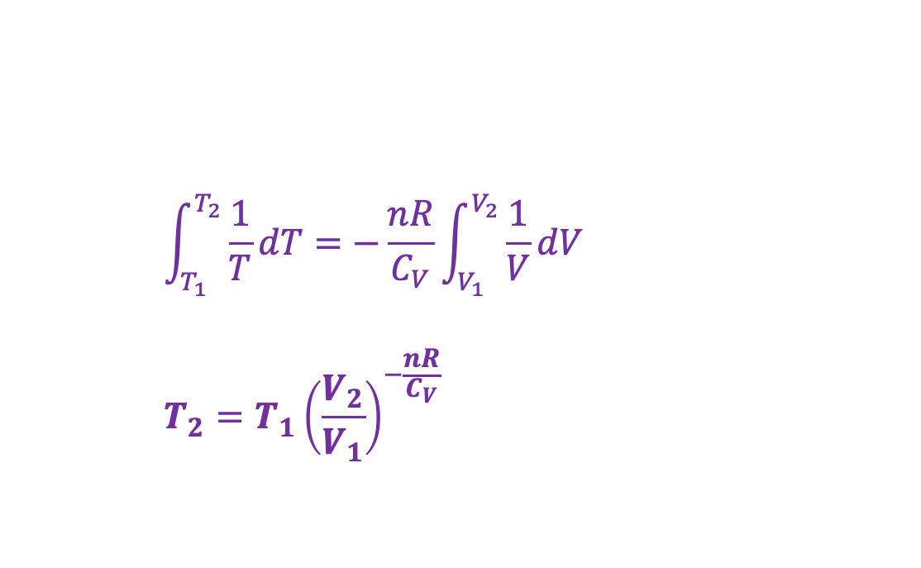



Multi-step adiabatic expansion of an ideal gas
$$\int_{T_{1}}^{T_{2}}{\frac{1}{T}dT}=−\frac{nR}{C_{V}}\int_{V_{1}}^{V_{2}}{\frac{1}{V}dV}$$
$$T_{2}=T_{1}{\left(\frac{V_{2}}{V_{1}}\right)}^{−\frac{nR}{C_{V}}}$$
$$U(T,V)$$
V
$$P_{ex}$$
T
$$P_{ex}$$
$$P_{2},V_{2}$$
$$T_{2}$$
$$P_{1},V_{1}$$
$$T_{1}$$
$$P_{ex}$$
No heat going in/out
Temperature is going down
$$P_{Ideal}=nRT/V$$
$$V_{1}$$
$$V_{2}$$

Slide 5

Multistep adiabatic expansion of an ideal gas in terms of pressure
$\frac{T_{2}}{T_{1}}={\left(\frac{V_{2}}{V_{1}}\right)}^{−\frac{nR}{C_{V}}}$
$P_{2}={P_{1}\left(\frac{V_{2}}{V_{1}}\right)}^{−\frac{nR}{C_{V}}−1}$
$$U(T,V)$$
V
$$P_{ex}$$
T
$$P_{ex}$$
$$P_{2},V_{2}$$
$$T_{2}$$
$$P_{1},V_{1}$$
$$T_{1}$$
$$P_{ex}$$
No heat going in/out
Temperature is going down
$$P_{Ideal}=nRT/V$$
$$V_{1}$$
$$V_{2}$$

Slide 6
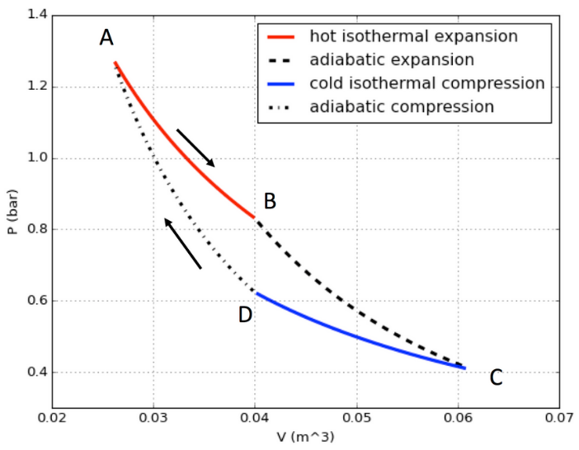

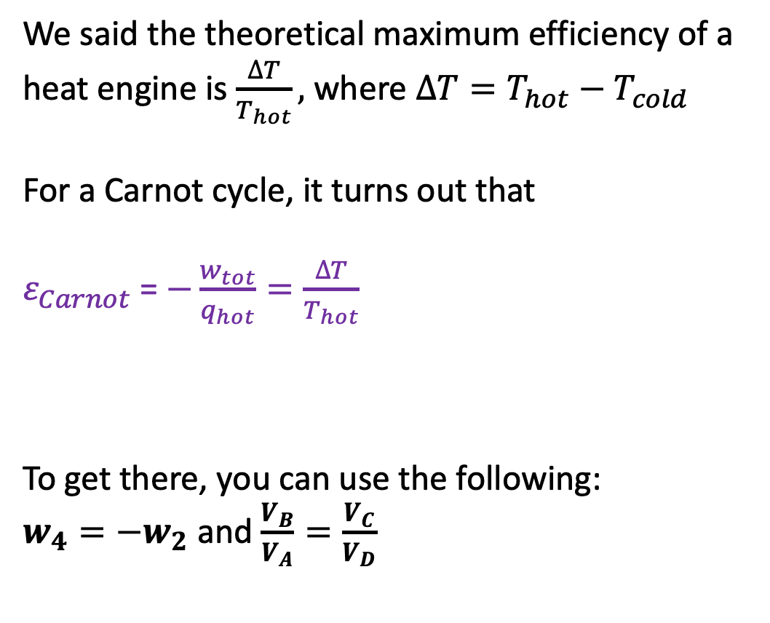



Carnot cycle’s efficiency is the theoretical maximum
We said the theoretical maximum efficiency of a heat engine is $\frac{∆T}{T_{hot}},$where $∆T=T_{hot}−T_{cold}$
For a Carnot cycle, it turns out that
$ε_{Carnot}$= $−\frac{w_{tot}}{q_{hot}}=\frac{∆T}{T_{hot}}$
To get there, you can use the following:
$w_{4}=−w_{2}$ and $\frac{V_{B}}{V_{A}}=\frac{V_{C}}{V_{D}}$
$$w_{1}$$
$$w_{2}=−880 J$$
$$w_{4}=\text{+880 }\text{J}$$
$$w_{3}$$

